Slide 1
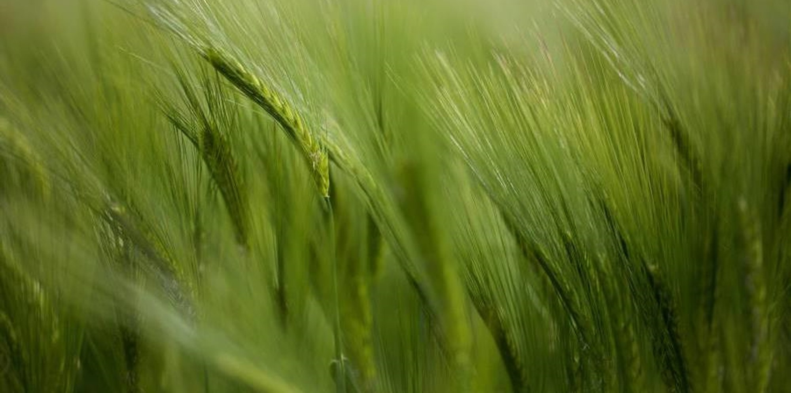

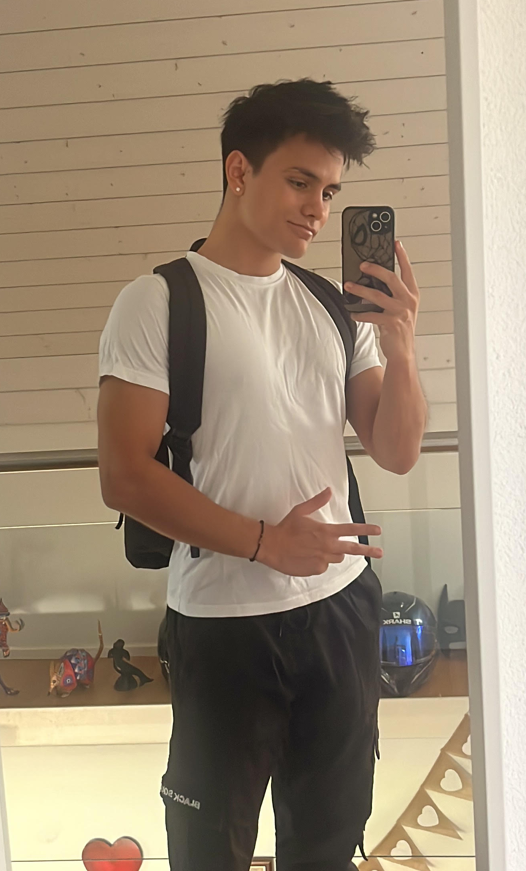




Daniel Perez Garza
University: Eastern Switzerland University of Applied Sciences
Study program: Renewable energies and environmental technology
Year of study: 3. Semester
City: Rapperswil SG, Switzerland
Motto for life: Take it easy and chase what makes you happy
Hobbies: Volleyball, Sports, drawing, listen to music, hiking
Your expectations from the summer school:
Learn more about sustainable systems and meet new people internationally
Where my roots are from
Where I work, study and live
Karlsruhe
31 August to 11 September 2026

